Slide 1



Mid bootcamp setup

Slide 2


CONTENTS
Repo structure
Environments
Installing libraries in a given environment.
Initializing a Git repository
Adding a GitHub repository
Git directives
Yaml file

Slide 3
Repo structure

Slide 4
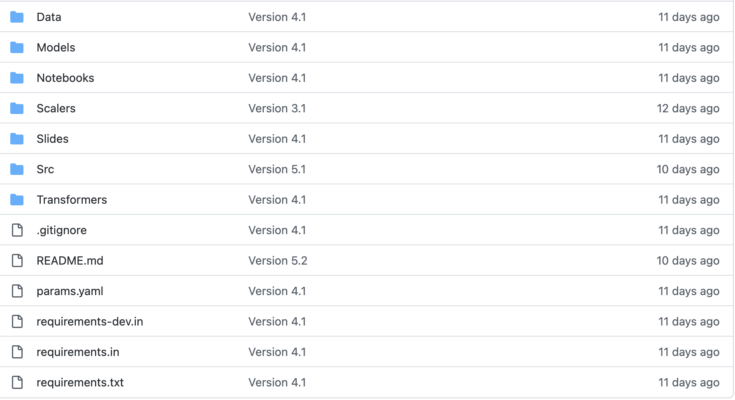
Repo files

Slide 5
Repo files
Add the following files to your repo:
README.md -> Introduce the purpose of your project and provide your findings and next steps to go. Also add a link to your data source.
requirements.in ->a list of libraries used in your project alongside with the specific version for a production environment.
requirements-dev.in -> a list of libraries used in your project alongside with the specific version to be used in your jupyter notebook.
params.yaml -> yaml file with all the settings used in your project (folders, random_seeds, neighbours,...etc)
.gitignore -> include all the files that you don’t want to commit.

Slide 6
Repo folders (I)
Add the following folders to your repo:
data/
raw/data.csv
cleaned/data_cleaned.csv
slides/
Add here any presentation/tableau workbook

Slide 7
Repo folders (II)
If you create a machine learning model, add the following folders to your repol:
transformers/
Store here any fitted transformer
scalers/
Store here any scaler
encoders/
Store here any encoder
models/
Store here all your models

Slide 8
Repo folders (III)
Add the following folders to your repo:
notebooks/
Exploratory notebook -> Here you do all your tests (include Markdown cells with comments about what and why you do what you do)
[Clean_notebook]
I you create a model, you can optionally create this ones:
src/
main.py -> Python file to load, clean and train, and save your models
lib/
functions.py
__init__.py

Slide 9
Repo folders (IV)
functions.py:
Add any import needed by the functions OUTSIDE THE FUNCTION
Add all the functions
Add the following line at the end of your file:
if __name__ == “__main__”:
function1()
function2()
This allows you to run the enclosed code from:
jupyter notebook
the terminal.

Slide 10
Repo folders (V)
If you create an app, add the following folders to your repo:
app/
Any Python file to create a frontend.

Slide 11
Environments

Slide 12
Environment
An environment is an isolated space in your computer to install specify versions of your libraries.
By default, all the anaconda installations comes with one default environment called “base” in which all the libraries are installed.
When we open a new terminal, by default it will be opened in the default conda “base” enviroment!
Create an environment in your mid-bootcamp project folder!

Slide 13
Environment tools
The two main environment tools available in Python are:
Conda
Anaconda can only “see” “conda” environments.
Every notebook opened with Anaconda is launched in the conda “base” environment.
Venv
It can be seen from VSCode, PyCharm, and others but not with Anaconda.
Others….

Slide 14
Conda environments

Slide 15
How to create an environment using conda
conda create --name environment_name pip python=3.9 jupyter
This will create a folder for the environment called “conda-env” in your current folder. In addition, it will install “pip”, “python3.9” and “jupyter” in the environment.
Afterwards, it’s interesting to install another library called “pip-tools” which is only available on the Python official repositories, not in conda. For this reason, we need to install it using “pip”
pip install -U pip pip-tools

Slide 16
Activating/deactivating conda environments
To activate a conda environment, move to the project folder and type
conda activate
To deactivate a conda environment, move to the project folder and type:
deactivate

Slide 17
Installing libraries in conda environments
To install libraries in conda environments:
Move to the project folder
Make sure that the environment is activated
Type:
conda install library_name
conda install library_name=version

Slide 18
Venv environments

Slide 19
How to create an environment using venv
Type:
python -m venv ./environment_name
This will create a folder for the environment called “environment_name” in your current folder

Slide 20
Activating/deactivating venv environments
Windows:
To activate the environment, move to the project folder and type:
environment_name\Scripts\activate
To deactivate the environment type:
deactivate
Linux/MacOS:
To activate the environment, move to the project folder and type:
source ./environment_name/bin/activate
To deactivate the environment type:
deactivate

Slide 21
Installing libraries in venv environments
Move to the project folder
Make sure that the environment is active.
Type:
python -m pip install --upgrade pip
After this, and in order to install any library type:
pip install library_name
If you want to install an specific version of the library use the syntax shown below.
pip install library_name==version
Every new environment will come almost with no libraries. Therefore, all the libraries must be installed.
Make sure that the new environment has been activated, and install “pip-tools”, “Jupyter”, “ipykernel”, Type:
pip install pip-tools jupyter ipykernel

Slide 22
Environments and Jupyter

Slide 23
Opening Jupyter notebooks in an environment
By default, Jupyter is not aware of new environments created externally.
We need to install a plugin to be able to open Jupyter notebooks in the new environments.
Therefore, we need to tell jupyter about the existing environment. We can do this by typing in the terminal:
python -m ipykernel install --user --name=environment_name
Afterwards we will need to close Jupyter an open it again to be able to select in which environment we want to launch the new notebook.
To launch a new jupyter notebook, open the terminal, move to the project folder, activate the environment, and type:
jupyter notebook

Slide 24
Requirements files

Slide 25
What is and why we want it?
A requirements file is a file that contains all the libraries needed to execute our programs, alongside with their versions.
This file is needed because sometimes we’re making use of some library functions not available in earlier versions. Therefore, our code will depend on which libraries we’re using and the corresponding versions.
In other words, having the same library installed in a third party system doesn’t give you any warranty that third parties can execute the repository code without errors.
Third parties need to know which libraries we were using in our project.

Slide 26
Generate a requirements using conda
Open the terminal
Activate the conda environment
Type:
conda env export --file requirements.yml

Slide 27
Generate requirements using piptools
Open the terminal
Activate the venv environment
Create a file named: “requirements-dev.in” with Sublime.
This file must contain a full list of all the library names used in your python programs
Create a file named: requirements.in with Sublime.
Add the line below:
-c requirements-dev.txt
Add any other library name not listed in the previous file like “jupyter”
To generate the requirements.txt and requirements-dev.txt, go to the project folder, make sure that you’re in the correct environment, and type:
.(venv) $ python -m piptools compile requirements-dev.in
.(venv) $ python -m piptools compile requirements.in
The previous commands will generate a new set of files (requirements.txt and requirements-dev.txt) in the current folder with the versions of all the libraries listed in the *.in files.

Slide 28
Initializing a Git repository

Slide 29
Initializing a git repository
Move to your project folder and type:
git init

Slide 30
Adding a GitHub repository

Slide 31
Initializing a GitHub repository and linking it
Go to your GitHub page and create a new repository.
Grab the url of your new GitHub repository
Open a terminal window into your project folder and type:
git remote add origin remote_url

Slide 32
Git steps

Slide 33
Mandatory (I)
At the end of every day:
Checkout your project folders for files bigger than 20MB.
Option A:
Skip Tableau workbooks and only include a Markdown file with the link to your public repo.
Compress data files bigger than 20MB
Add a .gitignore file and place inside any files/folders that you don’t want to commit.
Option B:
Use https://git-lfs.github.com/

Slide 34
Mandatory (I)
At the end of every day:
Add the files to the stack
Create a commit
Push your changes to your repo.

Slide 35
Yaml file

Slide 36
Yaml file
Is a configuration plain text file.
The purpose of this file is to host all the parameters needed by your notebooks/codes, ie:
Folders of data, transformers, scalers, models,....etc
Random seed
Hyperparameters of each of your models
It has a hierarchical structure
section:
Parameter: value

Slide 37
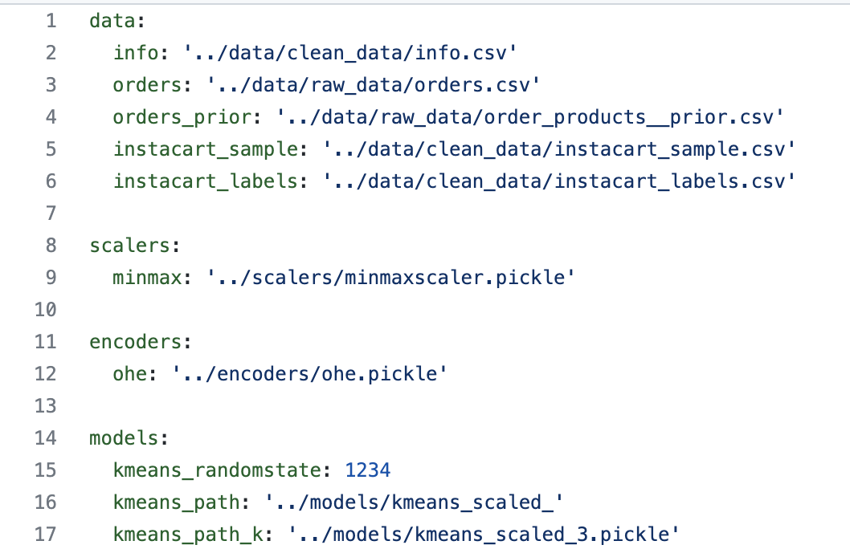
Example Yaml file

Slide 38
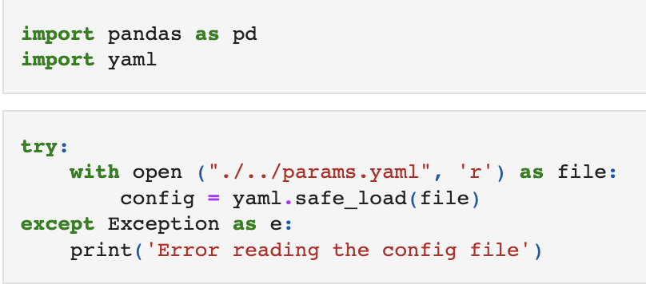
Reading a Yaml file in Python

Slide 39

Reading yaml files
To read a yaml file we need the library “yaml”.
import yaml
We can read and store all the parameters from a yaml file using:
with open(“path_to/parameters.yaml”) as conf_file:
config = yaml.safe_load(conf_file)
“config” variable is a “nested” dictionary:
config[‘train’][‘neighbours’]....

Slide 40
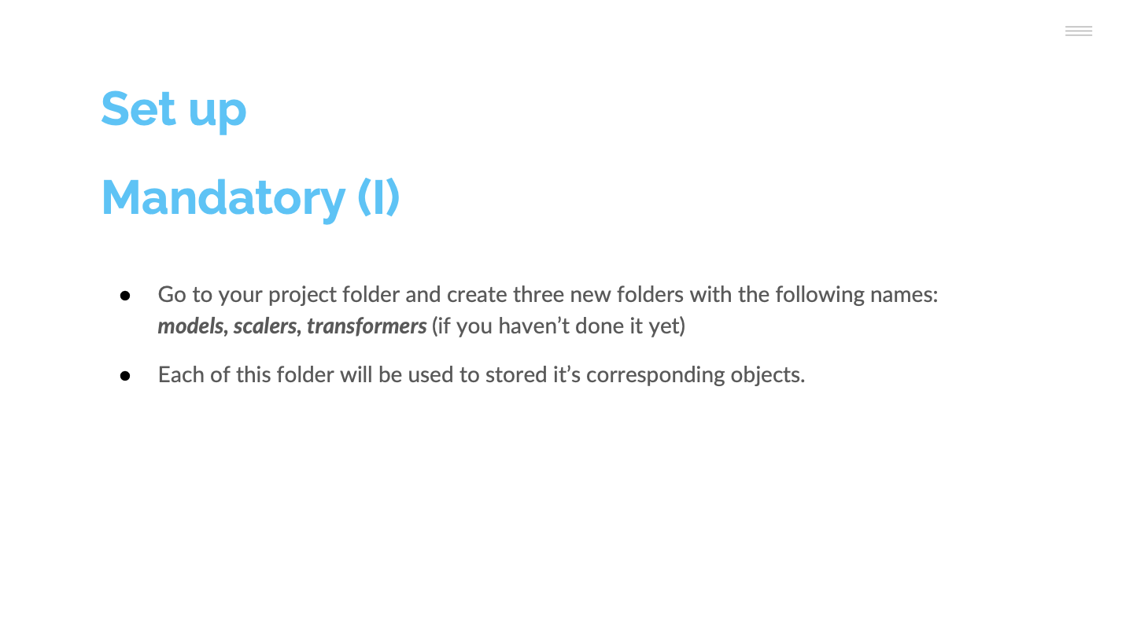
Yaml file
Is a configuration plain text file.
The purpose of this file is to host all the parameters needed by your notebooks/codes, ie:
Folders of data, transformers, scalers, models,....etc
Random seed
Hyperparameters of each of your models
It has a hierarchical structure
section:
Parameter: value

Slide 41
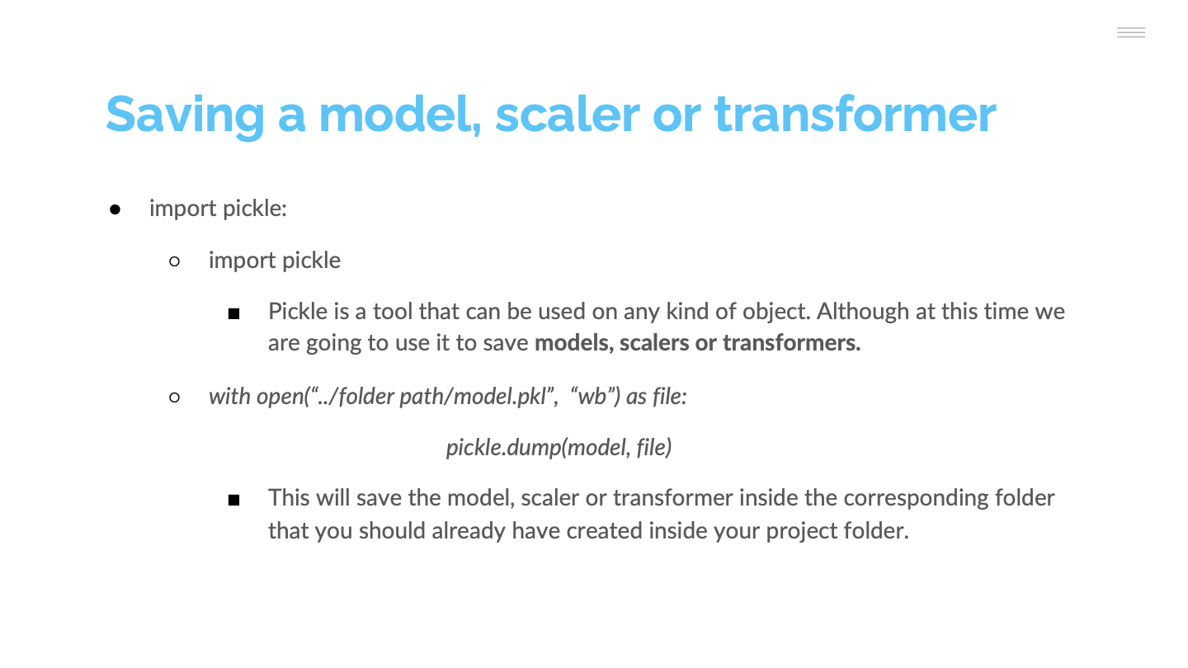

Slide 42
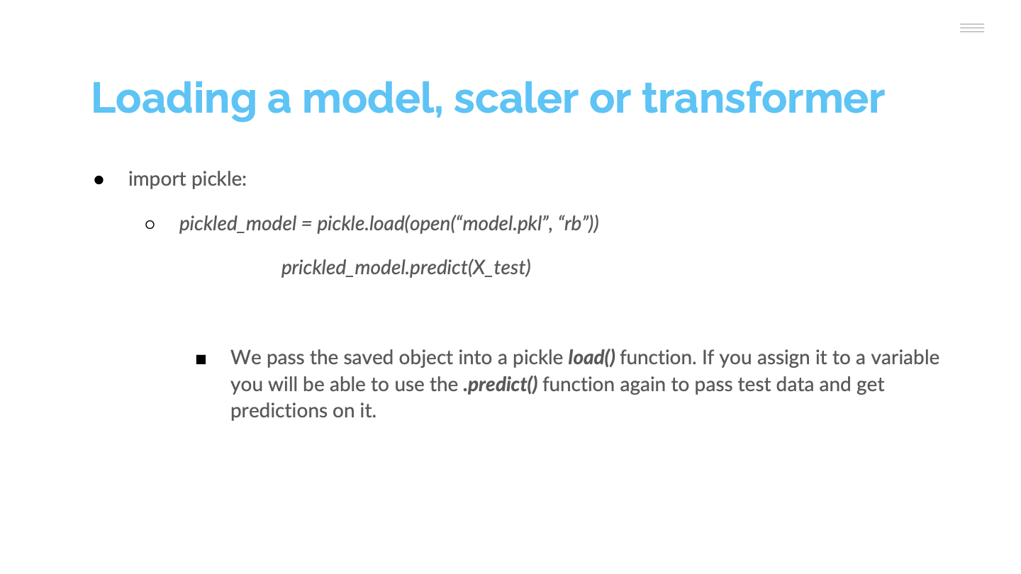

Slide 43


